Slide 1

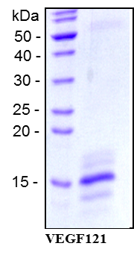
ReliaTech GmbH
Recombinant human VEGF121
(Cat #300-031S / -031 / -032)
Fig. 1: SDS-PAGE analysis of recombinant human VEGF121 produced in insect cells. Sample was loaded in 15% SDS-polyacrylamide gel under reducing conditions and stained with Coomassie blue.
http://www.reliatech.de / orders@reliatech.de

